Slide 1
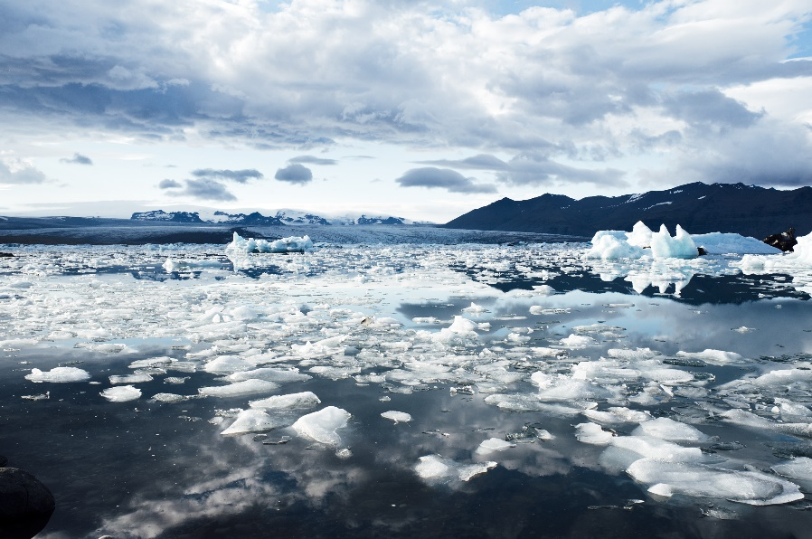
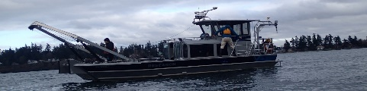

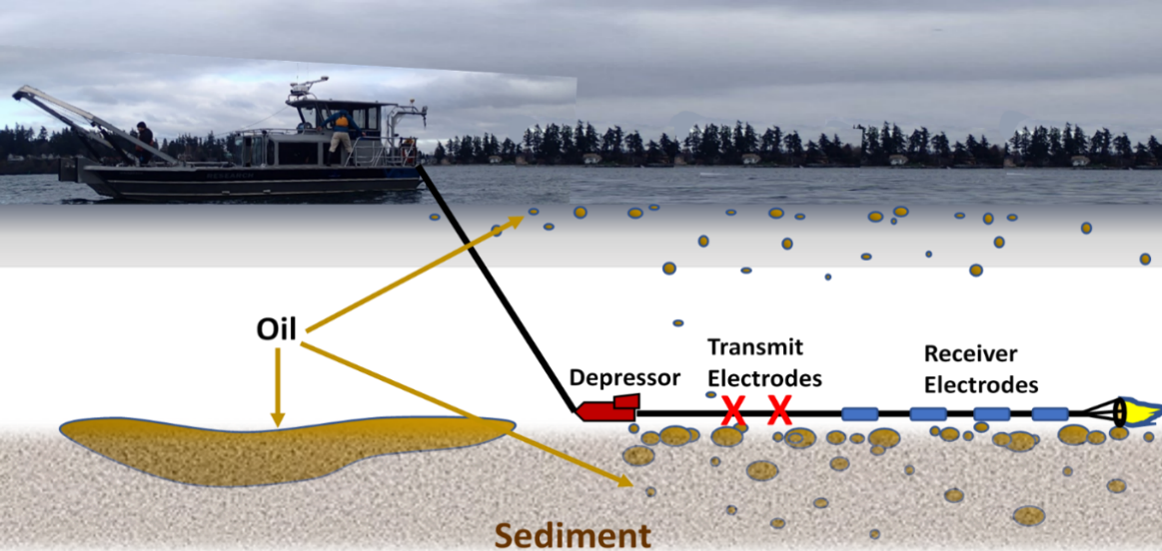
ADAC Annual Meeting
Marine Induced Polarization - Detection and Mapping of Oil Under Ice
Researcher Kari Walker, IntelliSense Marine LLC
PI Dr. Scott Socolofsky, Texas A&M University

Slide 2
ADAC Project: Marine Induced Polarization Methods for the Detection and Mapping of Oil in an Arctic Marine Oil Spill - Including Investigation of Oil Within and Under Broken Ice Fields
ADAC Annual Meeting: 14 May 2020
• Project Principal Investigator: Dr. Scott Socolofsky, Texas A&M University
• Supporting Team:
  Ms. Kari Walker and Mr. Kevin Hand, IntelliSense Marine
  Mr. Art Wright, Mr. Jay Radler and Mr. Todd Stedman, Induced Polarization Associates
  Mr. Nathan Lamie, Lead Engineer/Facility Operator, Cold Regions Research and Engineering Laboratory, U.S. Army Corps of Engineers
  Dr. Jeff Wynn, USGS (Ret), (Marine IP nationally recognized expert)
• Project Champion: LT Matt Edes, USCG CG-MER

Slide 3
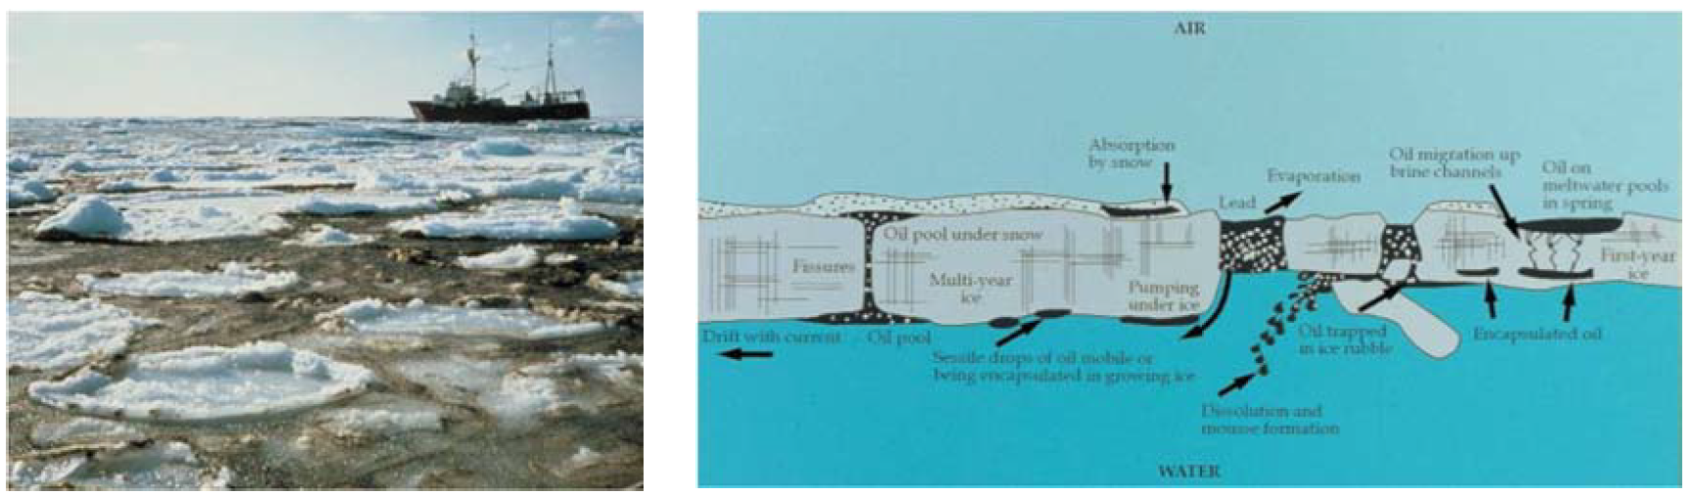
Marine IP: Project Description and Baseline
ADAC Annual Meeting: 14 May 2020
Project Description: Federal on-scene spill responders need remote sensing tools to detect and map oil in the open-Arctic ocean, broken ice fields, as well as oil under and within ice. This research effort will test and evaluate (T&E) the performance of Marine Induced Polarization (Marine IP), a U.S. Geological Survey (USGS) patented technology, which locates and assesses low percentage polarizable mineral and particle distributions - such as hydrocarbons - in water, ice and in sediment.
Baseline: A gap in current Arctic spill response technology is the ability to detect and map oil that collects in ice-infested waters - on the under side of ice, or on and in seafloor sediment.

Slide 4
Marine IP: Method
ADAC Annual Meeting: 14 May 2020
Oil on and within seafloor sediment:
A cable is towed behind a vessel
Transmit electrodes emit a controlled electrical current
Receiver electrodes measure changes in the return signal caused by substances encountered
Oil
Transmit Electrodes
Receiver Electrodes
Depressor

Slide 5
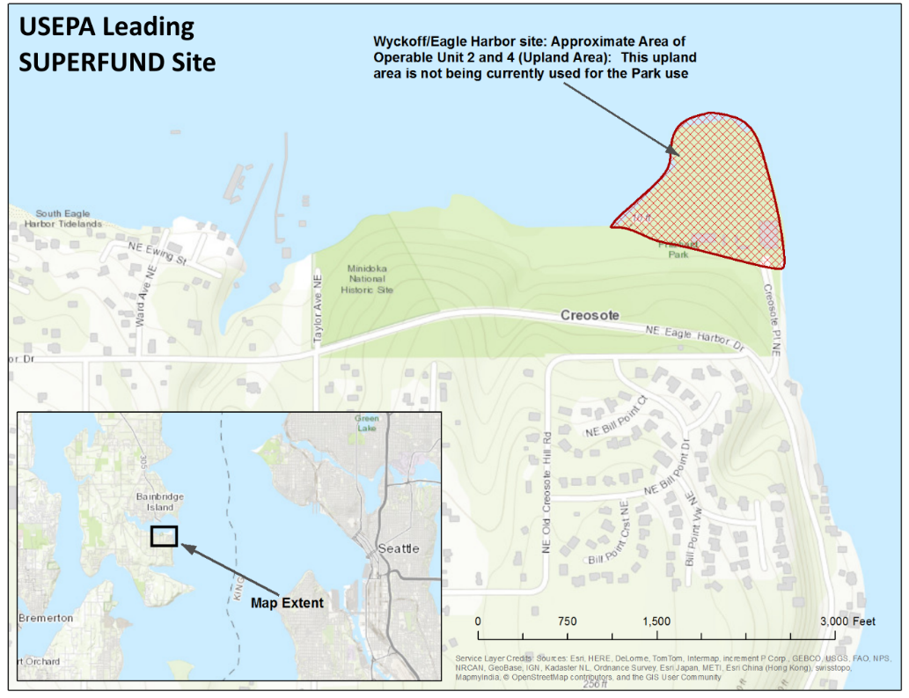
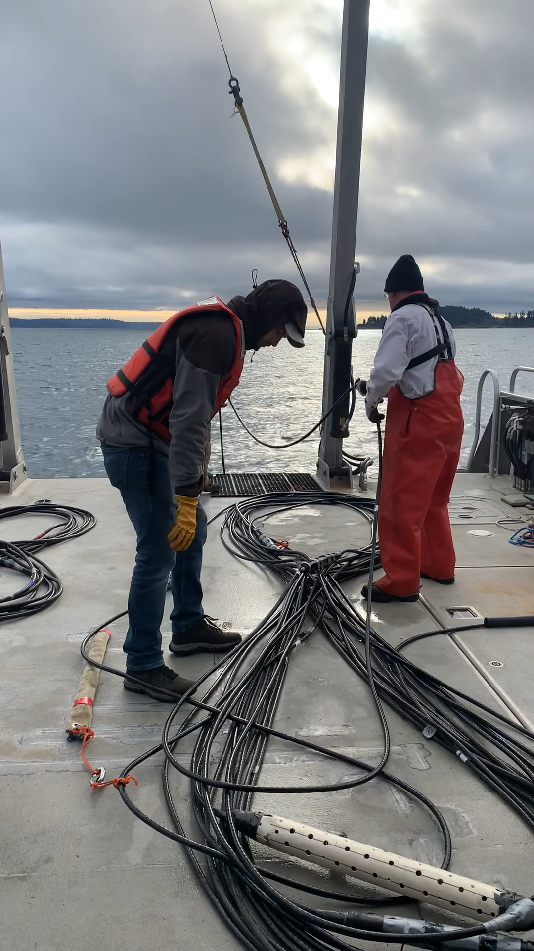
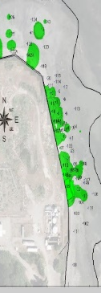
Marine IP: Method
ADAC Annual Meeting: 14 May 2020
Cable Deployment
Oil on and within seafloor sediment:
Marine IP open water survey in Puget Sound, WA
Wyckoff Superfund Site
Water depth ~35ft (~10m)
Eagle Harbor, WA
Survey Pattern
Seattle, WA
Wyckoff Site
Image and data from the 2012 EPA Field Investigation Technical Memorandum Wyckoff OU-1 Focused Feasibility Study

Slide 6
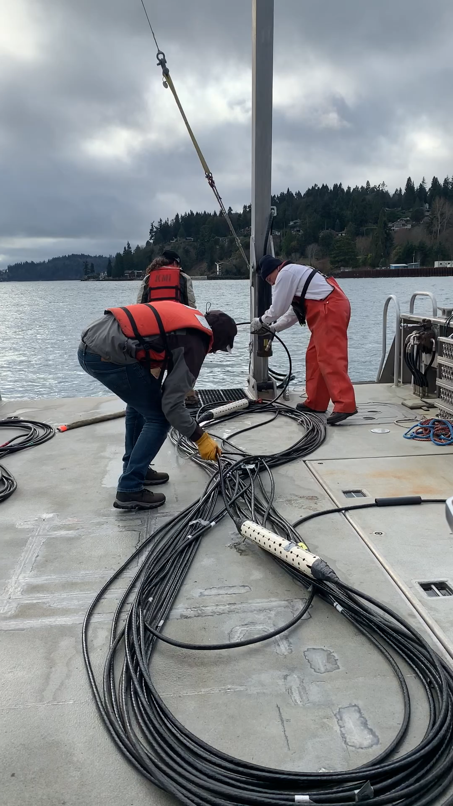
Marine IP: Method
ADAC Annual Meeting: 14 May 2020
Cable Recovery
Oil on and within seafloor sediment:
Marine IP open water survey in Puget Sound, WA
Wyckoff Superfund Site
Water depth ~35ft (~10m)
Eagle Harbor, WA
Survey Pattern
Seattle, WA
Wyckoff Site
Image and data from the 2012 EPA Field Investigation Technical Memorandum Wyckoff OU-1 Focused Feasibility Study

Slide 7
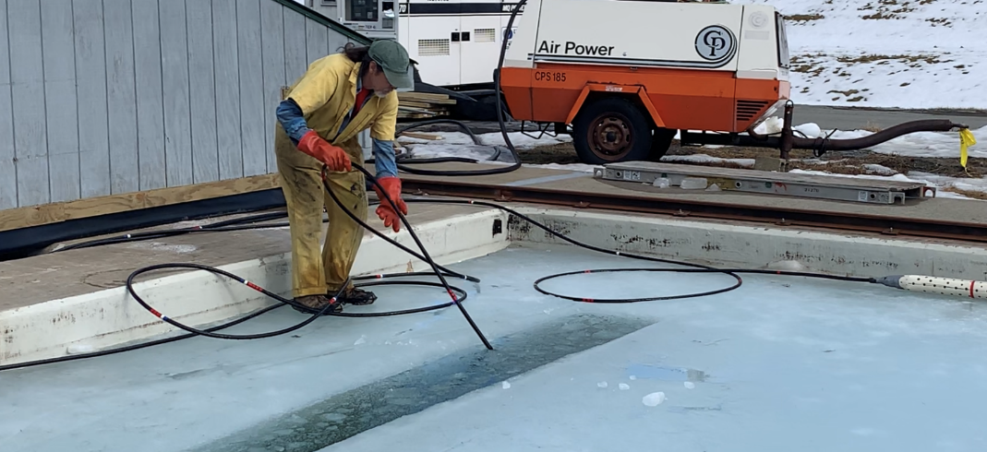
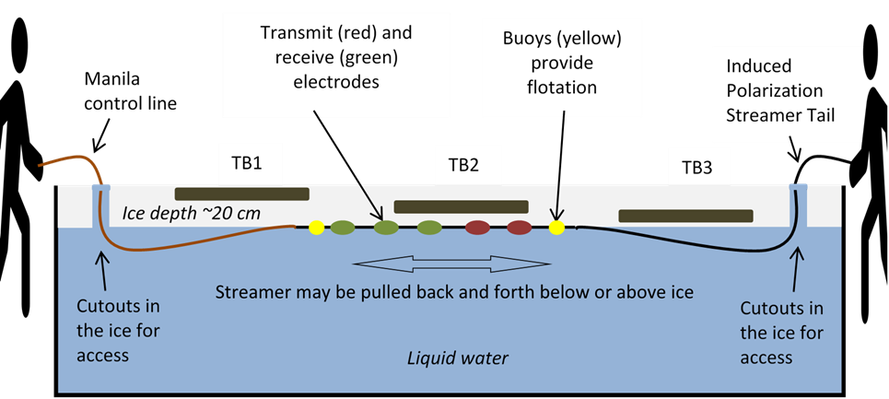
Marine IP: Method
ADAC Annual Meeting: 14 May 2020
Oil-Under-Ice testing: CRREL Testing Facility
A cable streamed under tank ice
Transmit electrodes emit a controlled electrical current
Receiver electrodes measure changes in the signal due to substances encountered
Transmit (red) and receive (green) electrodes
Induced Polarization Streamer Tail
Buoys (yellow) provide flotation
Control line

Slide 8
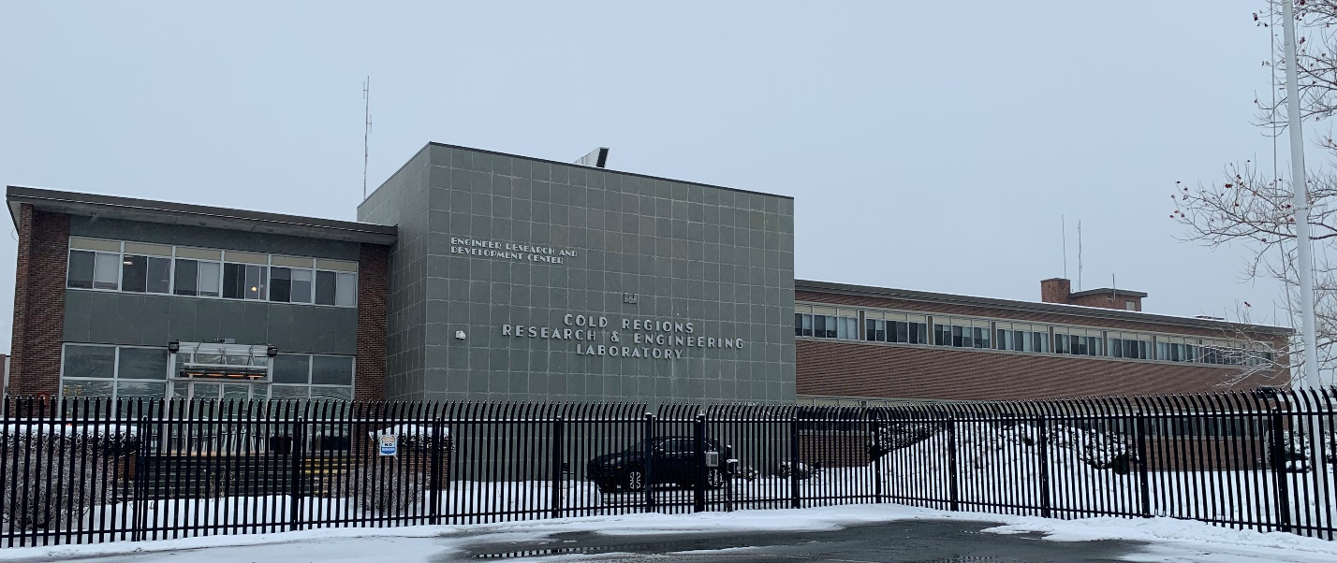
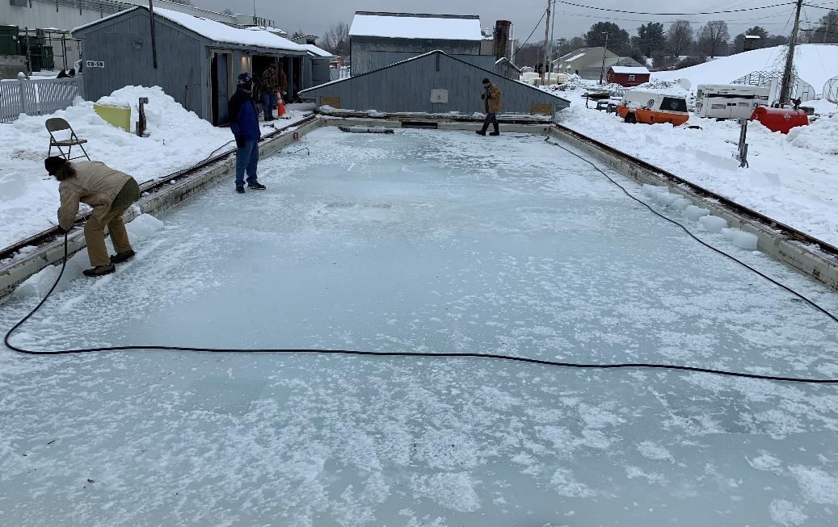
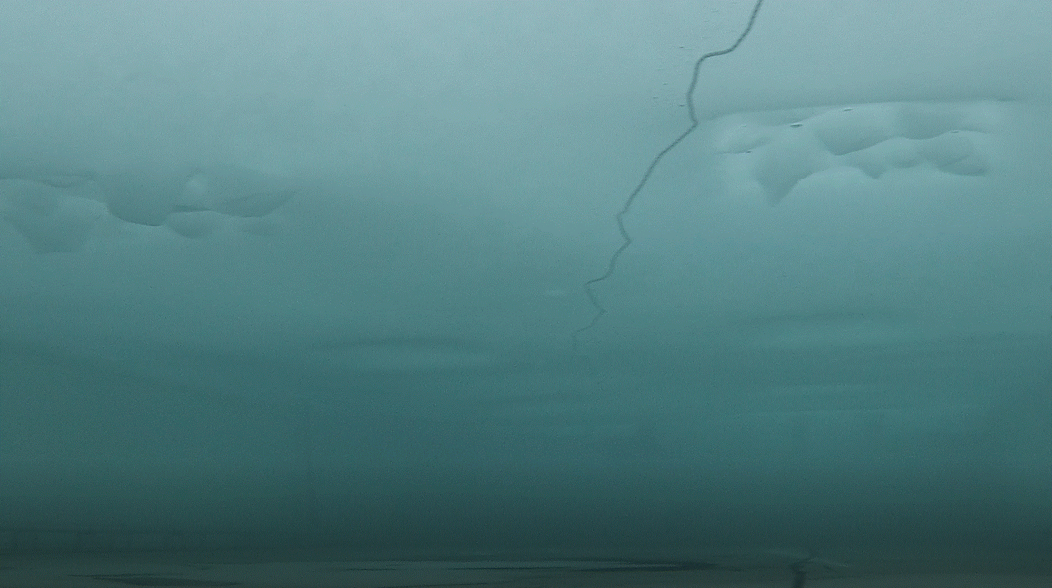
Marine IP: Method
ADAC Annual Meeting: 14 May 2020
Cold Regions Research & Engineering Laboratory (CRREL)
Oil-Under-Ice testing:
CRREL Testing Facility:
Study design included 6 test scenarios:
  Oil under solid ice
  Oil encapsulated within ice
  Oil in pockets under broken and refrozen ice.
  Oil in broken ice
  Controls: Broken ice and solid ice, no oil added
View of ice from below

Slide 9
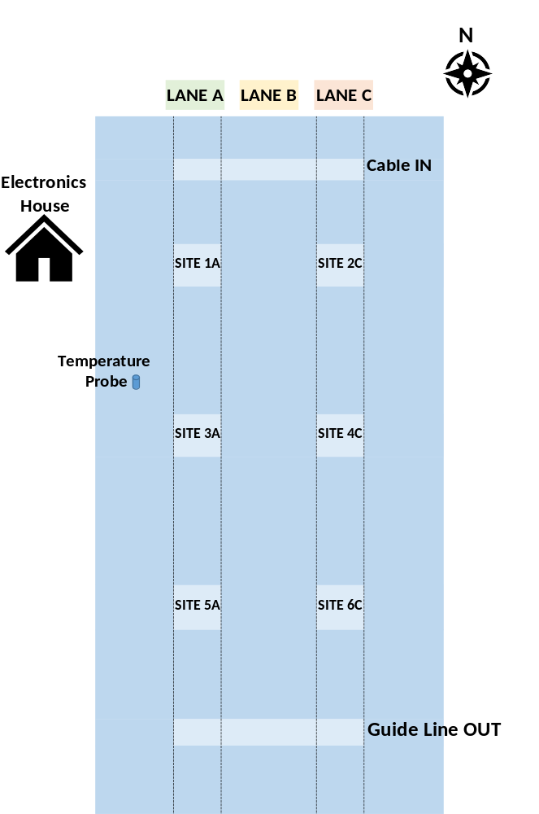
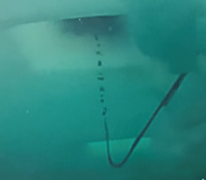
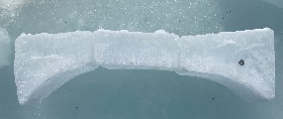
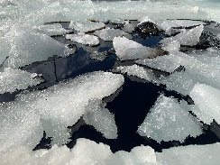
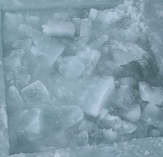
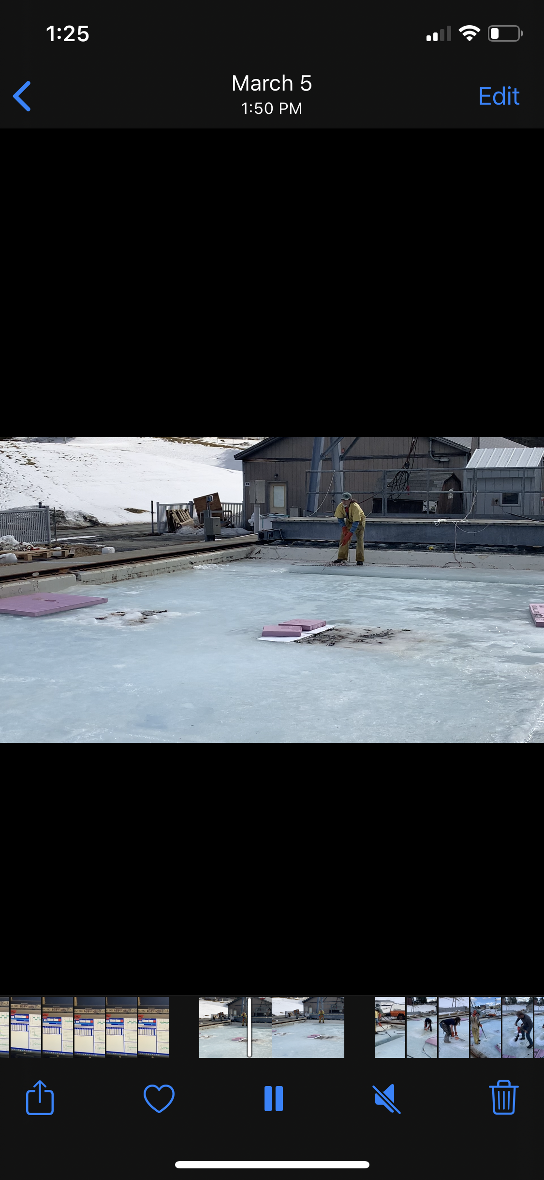
Marine IP: Method
ADAC Annual Meeting: 14 May 2020
Oil-Under-Ice testing:
CRREL Testing Facility:
Study design included 6 test scenarios :
  Site 1A: Solid ice, encapsulated oil and Oil under solid ice
  Site 2C: CONTROL: Solid ice - NO OIL
  Site 3A: Broken ice with oil to surface
  Site 4C: CONTROL: Broken ice - NO OIL
  Site 5A: Broken ice, oil to surface, encapsulated oil
  Site 6C: Broken ice, rough bottom, encapsulated oil
1st measurement
2nd measurement, added bottom oil

Slide 10
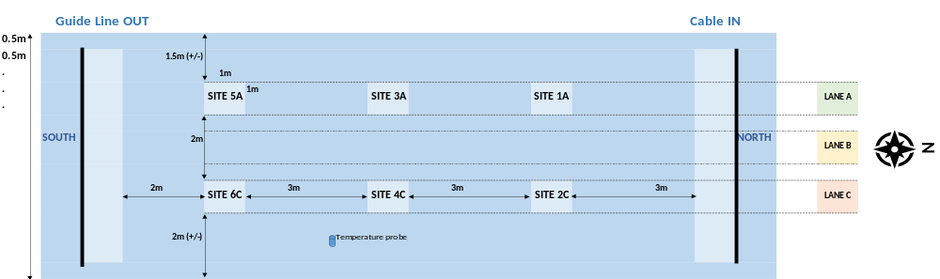

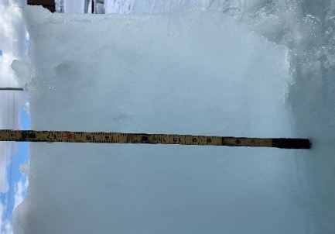
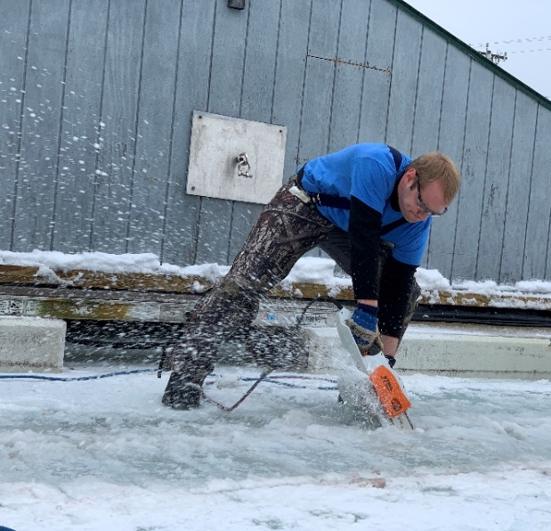
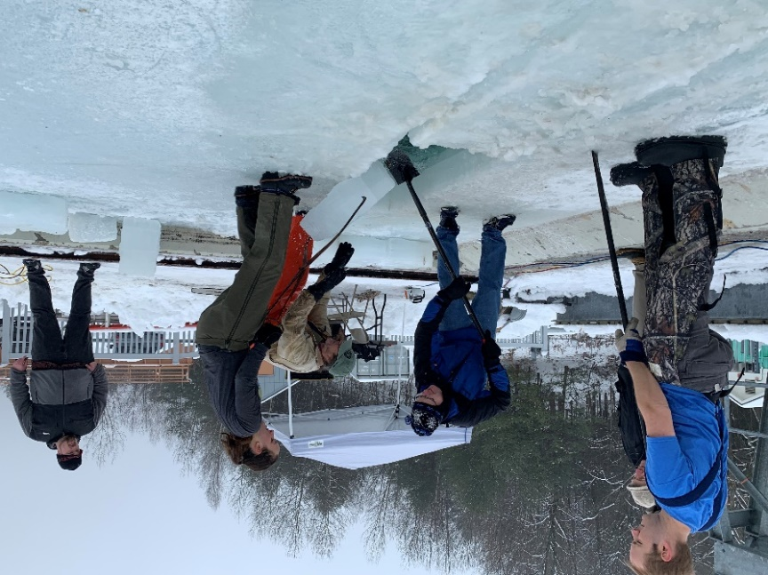
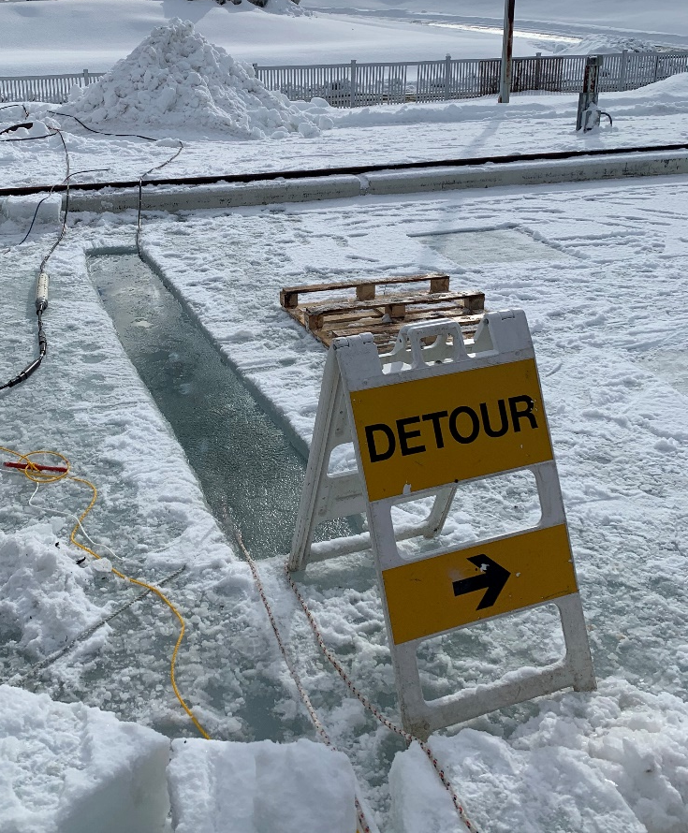
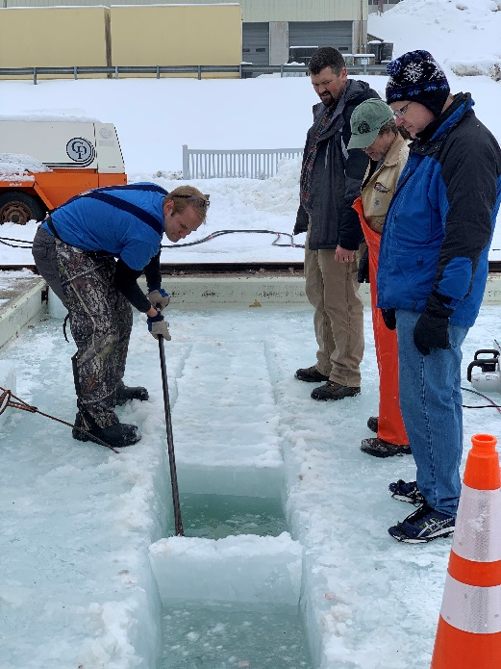
Marine IP: Method
ADAC Annual Meeting: 14 May 2020
Planned Layout of Study Sites
Oil-Under-Ice testing: CRREL
February 11-13, 2020:
Preparing the ice
Open Water
Open Water
N
18 in
Complete
Cutting out ice blocks
Breaking blocks apart
Removing blocks

Slide 11
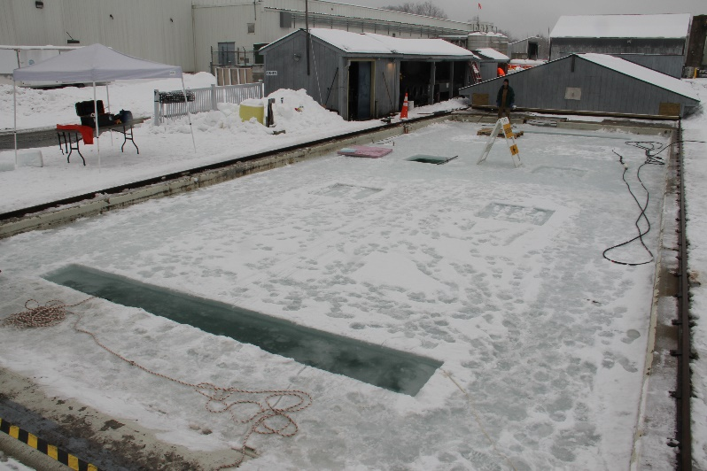
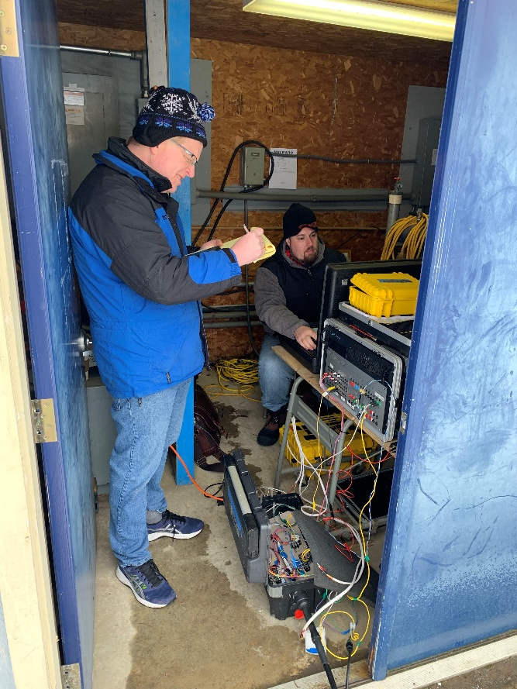
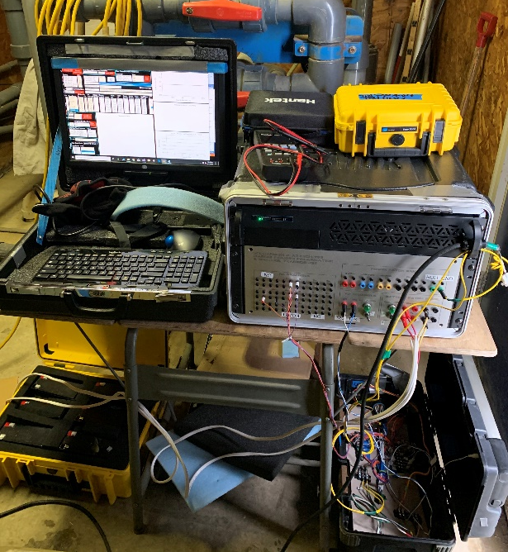
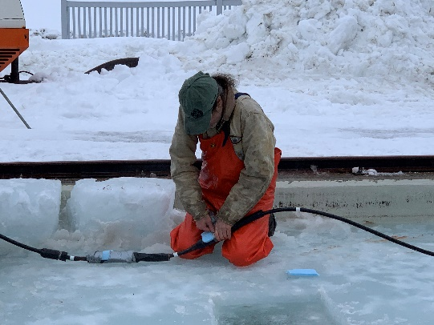
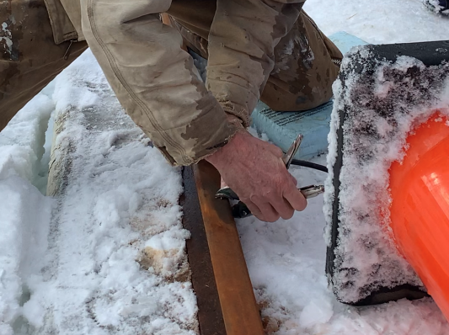
Marine IP: Method
ADAC Annual Meeting: 14 May 2020
Oil-Under-Ice testing: CRREL
February 11-13, 2020:
  Equipment set up
Adding floatation
Connecting ground wire

Slide 12
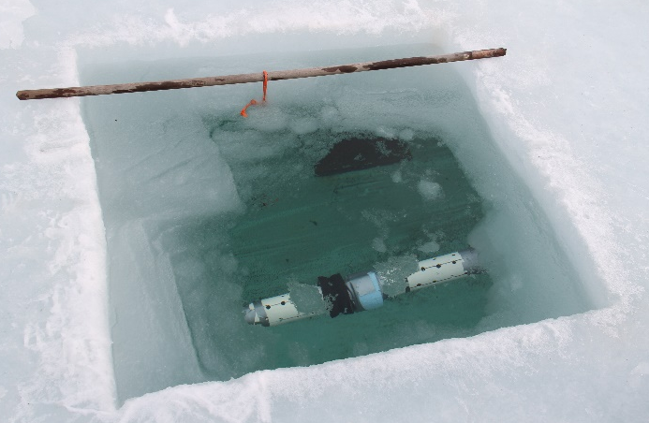
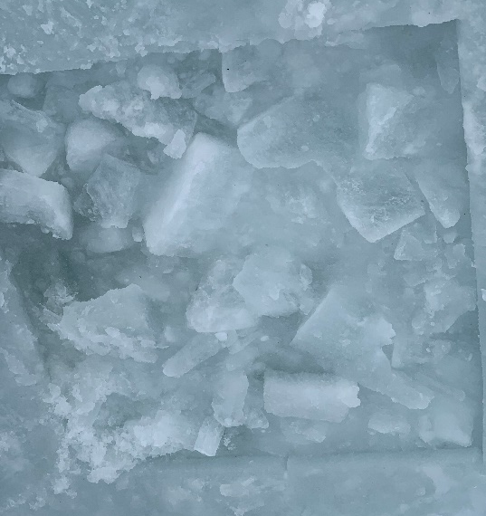
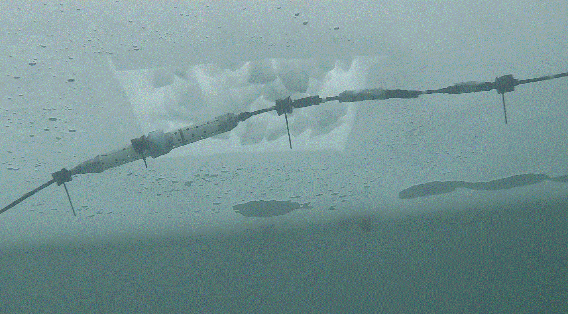
Marine IP: Method
ADAC Annual Meeting: 14 May 2020
Oil-Under-Ice testing: CRREL
February 11-13, 2020:
  Collecting baseline measurements
View of ice from below

Slide 13
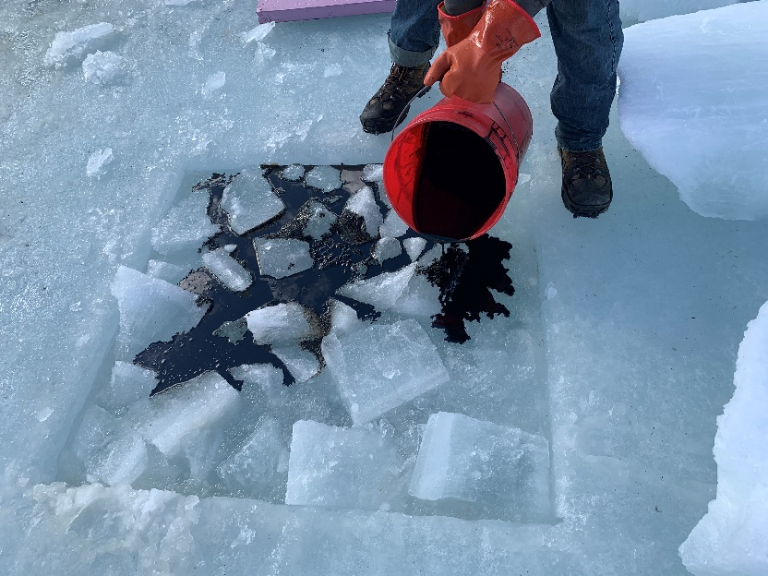
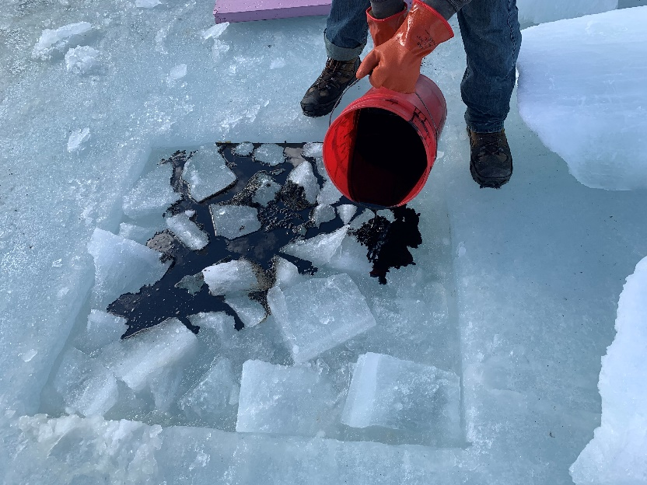
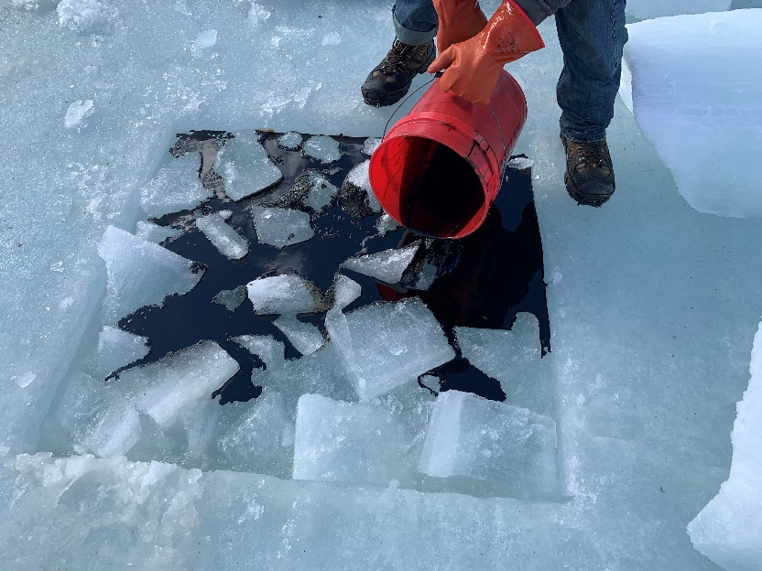
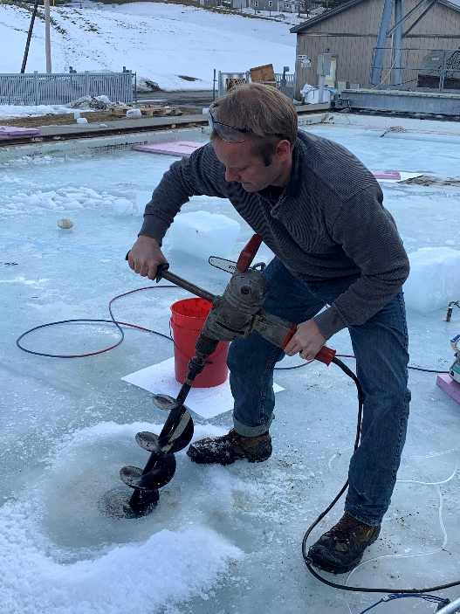
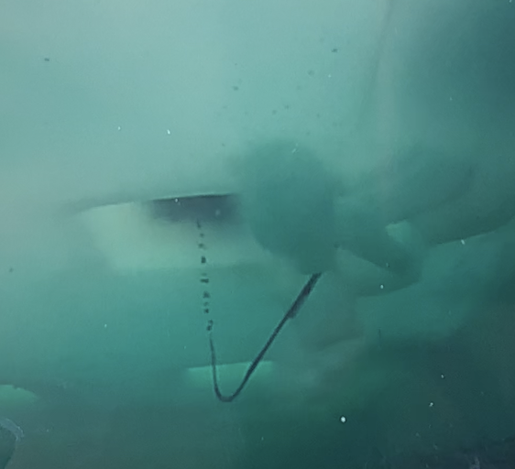
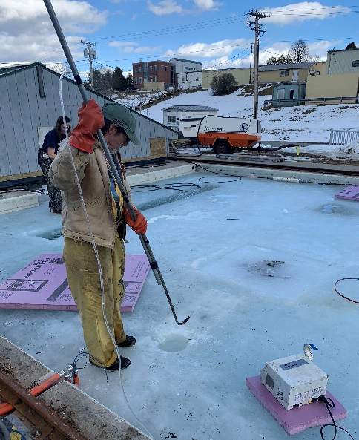
Marine IP: Method
ADAC Annual Meeting: 14 May 2020
Oil-Under-Ice testing: CRREL
March 3-5, 2020:
  Preparing for oil under ice measurements
Adding oil to broken ice,
oil to the surface
Adding oil under solid ice
View of ice from below

Slide 14

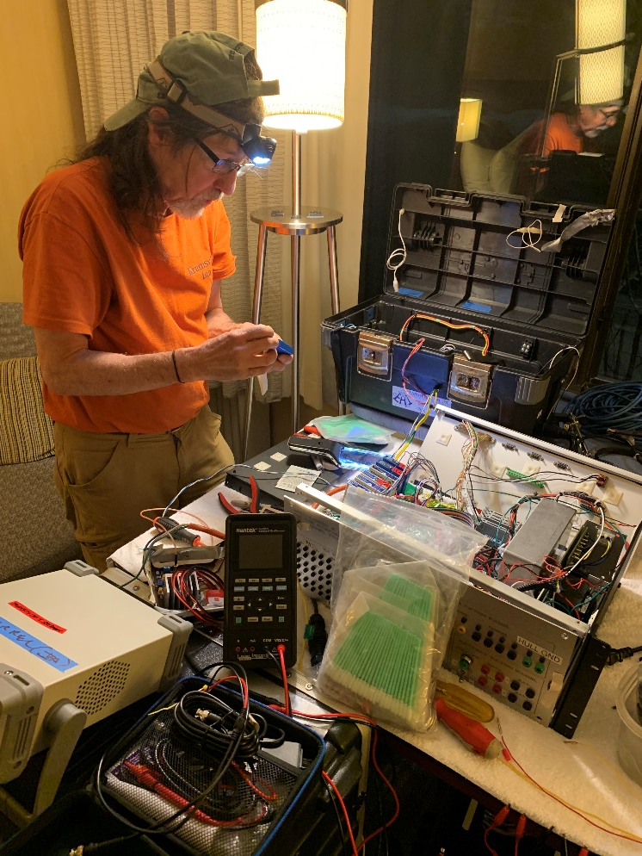
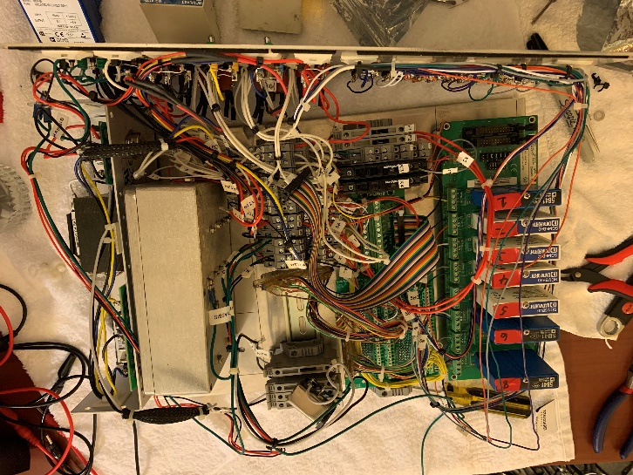
Marine IP: Method
ADAC Annual Meeting: 14 May 2020
Marine IP Data Acquisition System
for signal generation and processing
Oil-Under-Ice testing: CRREL
March 3-5, 2020:
  Oil under ice measurements
  Challenges:
  Equipment dropped during shipping, resulted in sheared bolts and caused power source to break free in box
  2-day rebuild
Rebuild
Power source box

Slide 15
Marine IP: Method
ADAC Annual Meeting: 14 May 2020
Oil-Under-Ice testing: CRREL
March 3-5, 2020:
  Oil under ice measurements completed

Slide 16
Marine IP: Progress on Research
ADAC Annual Meeting: 14 May 2020
Project Milestones Completed:
All cables were built and tested:
Design, Build, Integrate and Beach Test Ice Cables
Design, Build, Integrate and Beach Test Open Water Cables
All field data was collected:
Open water field tests for the detection of hydrocarbons in sediment
Conduct baseline testing at CRREL for the detection of hydrocarbons under ice
Conduct oil under ice testing at CRREL
Preliminary data processing
Marine IP Spectral signatures:
Initial laboratory measurements conducted

Slide 17
Marine IP: Progress on Research
ADAC Annual Meeting: 14 May 2020
Project Milestones In Progress (On hold due to laboratory facility COVID-19 closure):
Marine IP Spectral signatures:
Complete laboratory measurements to apply to field data for final data processing and interpretation (estimated 2 weeks of lab data collection)
Data Processing and Reporting:
Complete data processing of field data from Open Water and CRREL oil under ice testing (estimated 3 weeks of data processing/analysis)
Complete preliminary engineering specifications to integrate Marine IP with an ROV/AUV (Q4)
Compete reporting

Slide 18
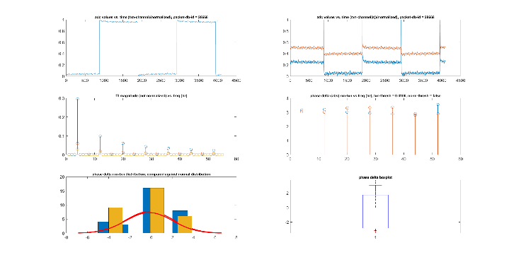
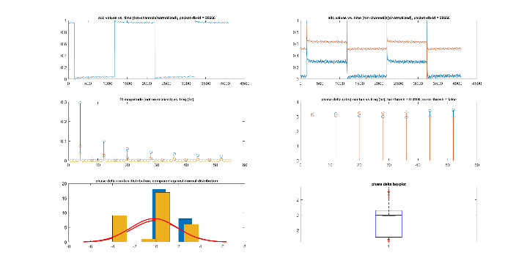
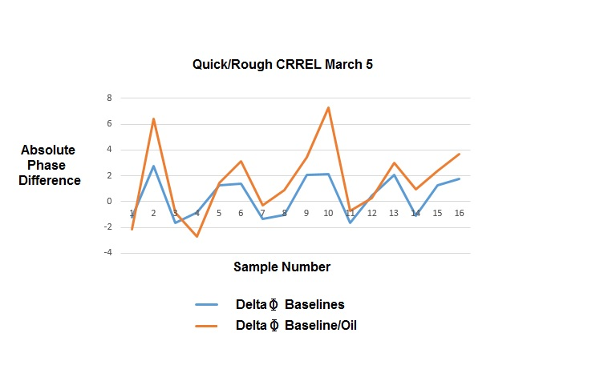
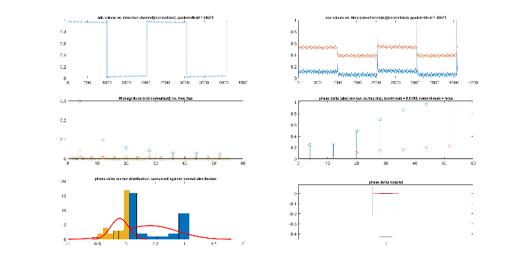
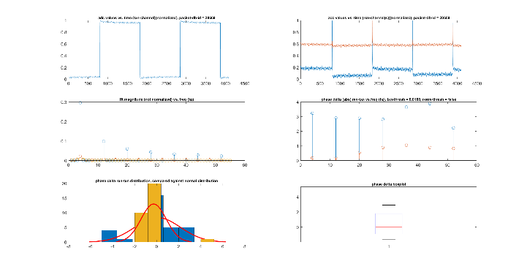
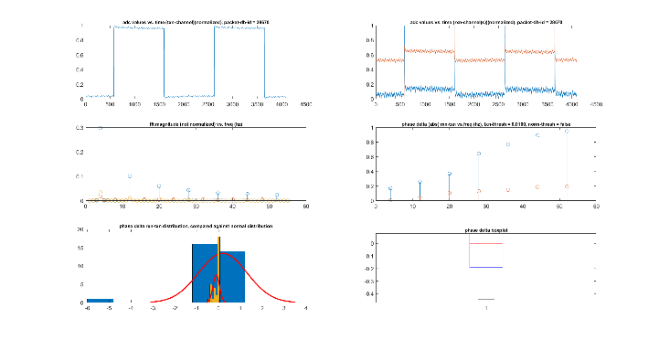
Marine IP: Progress on Research
ADAC Annual Meeting: 14 May 2020
Baseline measurement results:
Marine IP signal under ice, NO OIL
Oil-Under-Ice testing: CRREL
March 3-5, 2020:
  Preliminary results
Oil-Under-Ice measurements: OIL and NO OIL Comparison
Oil-Under-Ice measurement results:
Marine IP signal under ice, WITH OIL

Slide 19
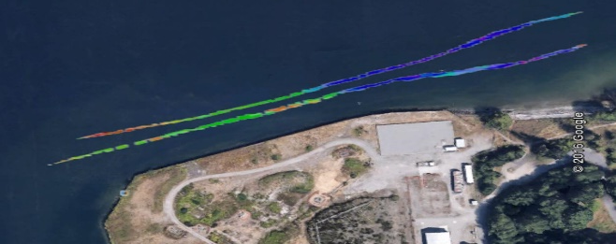


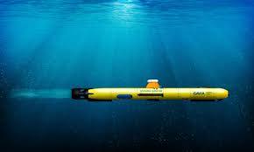
Marine IP: Progress on Research Objectives
ADAC Annual Meeting: 14 May 2020
Project Objectives:
Validate Marine IP as a tool in detecting and potentially characterizing contamination of hydrocarbons in Arctic waters: In progress, Q4
Investigate the potential of Marine IP to detect oil in partial ice formations as well as under pack ice: In progress, Q4
Investigate and determine Marine IP’s effectiveness to accurately detect the extent of contaminated areas: In progress, Q4
Identify preferred deployment mechanisms for characterization (such as ROVs or AUVs) : Q4
0.05 Δφ
Unpublished data results
0.00 Δφ
Wyckoff
Image and data from the 2012 EPA Field Investigation Technical Memorandum Wyckoff OU-1 Focused Feasibility Study
Eagle Harbor, WA

Slide 20
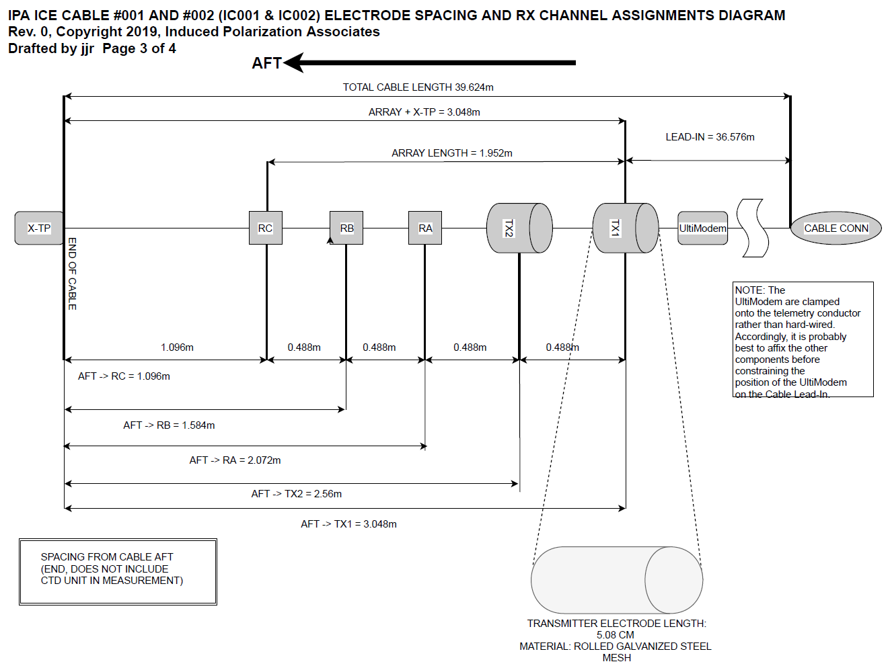

Marine IP: Progress on Milestones
ADAC Annual Meeting: 14 May 2020
Project Milestones:
Design Ice Cable that can be successfully tested in a simulated ice environment: Complete. Array length 2m.

Slide 21


Marine IP: Progress on Milestones
ADAC Annual Meeting: 14 May 2020
Project Milestones:
Construct and beach test Open Water Cable: Complete
Integrate Open Water Cable and transmitters/receivers into Marine IP control system: Complete

Slide 22





Marine IP: Progress on Milestones
ADAC Annual Meeting: 14 May 2020
Project Milestones:
Conduct post-cable integration beach tests: Complete
Cable markers
Clean signal from all receivers

Slide 23




Marine IP: Progress on Milestones
ADAC Annual Meeting: 14 May 2020
Project Milestones:
Complete open water field tests for the detection of hydrocarbons in sediment: Complete.

Slide 24




Marine IP: Progress on Milestones
ADAC Annual Meeting: 14 May 2020
Project Milestones:
Construct and beach test Ice Cable: Complete
Integrate Ice Cable and transmitters/receivers into Marine IP control system: Complete

Slide 25

Marine IP: Progress on Milestones
ADAC Annual Meeting: 14 May 2020
Project Milestones:
Determine the spectral signature of selected target contaminants utilizing a Marine IP system: In Progress, on hold due to laboratory facility COVID-19 closure

Slide 26

Marine IP: Progress on Milestones
ADAC Annual Meeting: 14 May 2020
CRREL Testing Facility
Project Milestones:
Conduct preliminary tests at CRREL for tank baseline detection results: Completed 10-13 February, 2020
Conduct ice tank testing of Marine IP in simulated ice conditions: Completed 2-6 March, 2020
Complete preliminary engineering design for specification for Marine IP integration with ROV/AUV operations: Q4
Complete data analysis and reporting: Q4
Study designs included:
6 test regions, 1m x 1m
1 oil type, ANS

Slide 27

Marine IP: Progress on Metrics
ADAC Annual Meeting: 14 May 2020
Project Metrics:
Document spectral signatures of tested polarizable materials with reliable accuracy: Lab Testing on hold, COVID-19 lab closure
Quantify minimum detectable concentrations of specified polarizable materials: Lab Testing on hold, COVID-19 lab closure
Specify distances for minimum concentration detections: In Progress
Percentage of blind targets found with Marine IP: Q4, Data Processing
Percentage of known hydrocarbons found at designated test site vs. documented (mapped) contaminant extent: Q4, Data Processing
Percentage of uptime vs. total active survey time during open-water surveys: Q4, Data Processing

Slide 28
Marine IP: Progress on Metrics
ADAC Annual Meeting: 14 May 2020
Project Metrics:
Examine capability of Marine IP to concurrently detect other submerged materials during hydrocarbons surveys: In Progress
Determine the capability and effectiveness of detecting oil in broken ice: In Progress
Determine what concentrations of ice formations (e.g. slush, broken, full ice sheet, etc.) allow effective hydrocarbon detection: In Progress
Determine the limit of detection in ice formations: In Progress
Determine size of interstitial space of ice in which petroleum is detectable: In Progress
Examine if ice formation or interstitial volume affects detectable concentrations: In Progress
Examine if different types of hydrocarbons affect the ability to detect in broken ice: In Progress

Slide 29


Marine IP: Progress on Outcomes/Outputs
ADAC Annual Meeting: 14 May 2020
Integrate Open Water Cable and transmitters/receivers into Marine IP control system: Complete
Design an Ice Cable to be tested in a simulated ice environment: Complete
Construct and beach test Ice Cable: Complete
Integrate Ice Cable and transmitters/receivers into Marine IP control system: Complete
Provide preliminary tests in open water environment: Open Water Survey Data Processing
Provide boat-based Marine IP test results in open water environment: Open Water Survey Data Processing

Slide 30


Marine IP: Progress on Outcomes/Outputs (Cont.)
ADAC Annual Meeting: 14 May 2020
Provide test results for Open Water Cable: Open Water Survey Data Processing
Provide the spectral signature information of selected target contaminants: In Progress, Lab Testing on hold
Provide preliminary CRREL tank baseline detection tests results: In Progress, Lab Testing on hold
Provide oil-in-ice simulated test results from CRREL tank facility for detection of hydrocarbons under and encapsulated within ice: In Progress, Lab Testing on hold
Provide preliminary engineering specifications for integrating a Marine IP system onto an AUV/UAV system for potential deployment in sea ice conditions : Q4

Slide 31






Marine IP: Update on feedback from Project Champion and other engagements
ADAC Annual Meeting: 14 May 2020
Project update e-mail February 13, 2020
Next project check-in meeting anticipated for May 2020, as available.
Seeking members of advisory committee:
  Would like to engage NOAA Office of Response and Restoration (ORR) POC
USCG R&D Center POC
USCG Pacific Area POC
USCG District 17 POC

Slide 32
Marine IP: Student Contributions
ADAC Annual Meeting: 14 May 2020
Students did not contribute to this research
One full-time employee and one part-time employee support this project, driving cable design, build, and testing, as well as supporting data processing and analysis

Slide 33




Marine IP: Update on Transition and TRL
ADAC Annual Meeting: 14 May 2020
The goal of this research is the utilization of Marine IP technology to enhance situational awareness for the USCG, DHS and other agencies relating to oil released in open or ice-laden water.
Steps to transition:
Demonstration of value and effectiveness for the USCG and other stakeholders through open water and simulated ice environment testing – ADAC Year 6 research.
Development of commercialized equipment, ruggedized for the Arctic environment – proposed ADAC Year 7 research.
The build and deployment of multiple Marine IP cables and detection systems for use by the USCG and other spill responders

Slide 34

Marine IP: Update on Transition and TRL
ADAC Annual Meeting: 14 May 2020
Steps to transition (Cont.):
Complete design parameters and engineering for applications of Marine IP with an autonomous underwater vehicle (AUV) to investigate under a solid-ice covered ocean surface.
Hands-on training for USCG and spill responders

Slide 35

Marine IP: Questions?
ADAC Annual Meeting: 14 May 2020
Feedback…
What are we missing?
What can we improve?
Who should we connect with to improve odds of research success?
Project team at CRREL during baseline testing.
From L to R: Karin Messenger (USCG), Scott Socolofsky (TA&M), Dana Tulis (USCG), Alexander Balsley (USCG R&D), Kari Walker (Marine IP), Nathan Lamie (CRREL)

